Slide 1
Detecting Common Coupling
Sungsoo Ahn, Ronaldo Goncalves Junior, Bennilyn Quek
Apr 28, 2016
Notes:
Top used, and least used global variables used by classes - class level

Slide 2
Table of Contents
Introduction to Common Coupling
Goals, Tools, and Target Systems
JDT / AST Approach
SrcML Approach
Final Report, Future Work
References

Slide 3
Introduction to Common Coupling
(A.K.A) Global Coupling
2 modules associated to same global data
e.g., usage of a global variable
Change to data imply changes to all modules using it
Java - What is a global variable?
public static variable (strong)
protected static variable (weak)

Slide 4
Goals, Tools, and Target Systems
Goals:
Detect common coupling in 2 systems programmed with Java
Compare the results of Eclipse JDT/AST and srcML
Tools:
Eclipse JDT/AST, srcML
System 1: Apache OpenNLP
Machine learning based toolkit for processing natural language text
Over 1k files (640+ java files)
Certain degree of common coupling (contains global variables)
System 2: FreeMind v1.0.1
System 3: OpenCMS Core (tag ms_9_4_7)
Notes:
Grep -r
Open NLP
605 files, 20% global variable

Slide 5
JDT/AST Approach
For each java file within the system
visit(FieldDeclaration node)
process fields with public static or protected static
visit(QualifiedName node)
Compare whether the global variables are used
Find the files where the global variables are used and get statistics
# of strong coupling (public static)
# of weak coupling (protected static)
Top 10 most used global variables
Store the results in a text file
* Used JDT / AST binding information

Slide 6
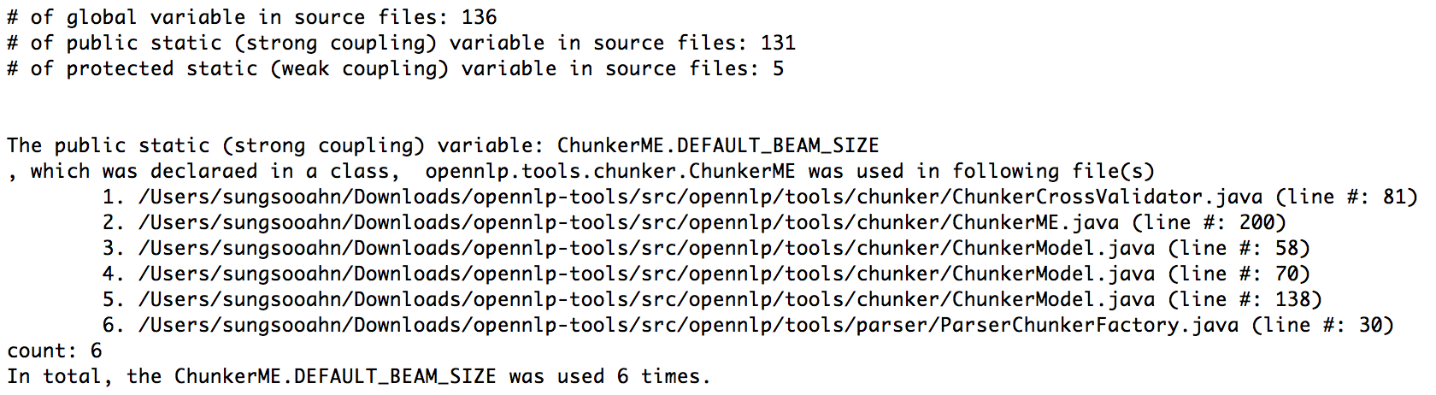
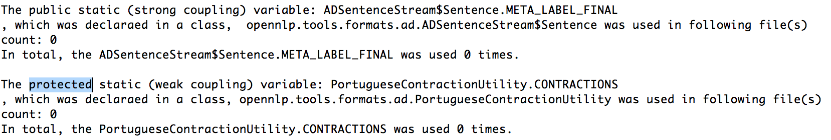
Getting Statistics and Uses of Global Variables (½)

Slide 7
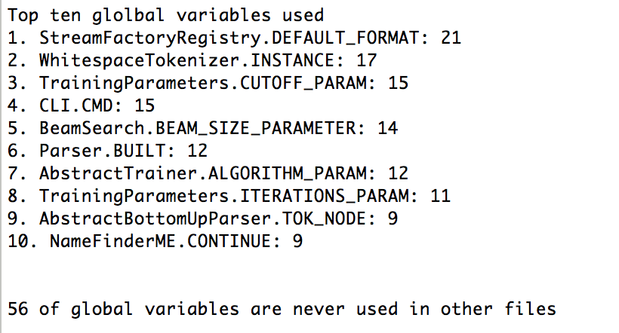
Getting Statistics and Uses of Global Variables (2/2)

Slide 8
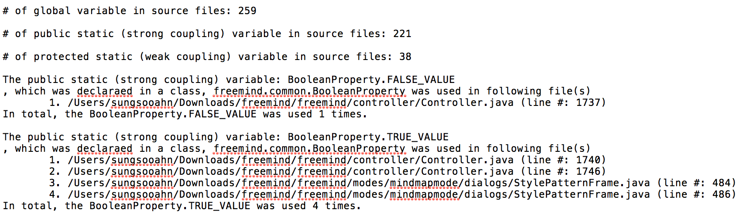
FreeMind Results (½)

Slide 9
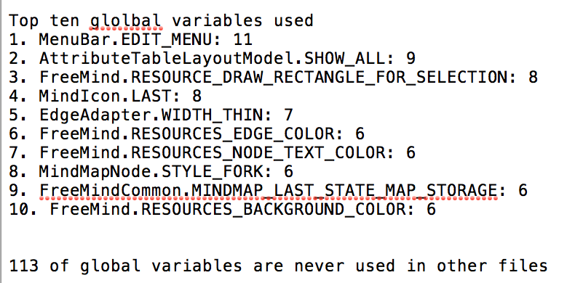
FreeMind Results (2/2)

Slide 10
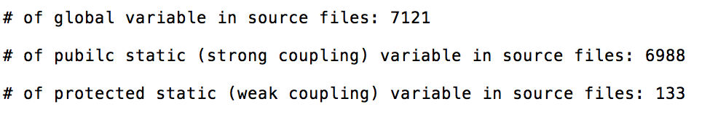
OpenCMS Result (½)

Slide 11
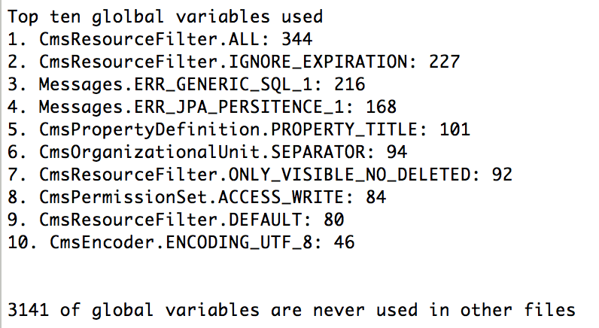
OpenCMS Result (2/2)

Slide 12
Testing (Validation)
Tested 4 small files (manually) for correct results
Gold Set was not created
Need to compare the results of other tools

Slide 13
SrcML Approach
Format the system to the respective format
Extract the required information
Detect common coupling within the system
Notes:
Format the system refers to generating the xml with srcml command.
Extract information refers to fileID and unitID with xpath
Detect coupling refers to iterating over the system files

Slide 14
SrcML - Implementation
Use SrcML to generate XML
srcml SimpleTokenizer.java -o SimpleTokenizer.xml
Use XPath & XQuery on Qutoric web tool
for $x in //decl[specifier='static']/name return /trace($x, $x)
for $x in //unit/class/name return /trace($x, $x)
EMPTY_ADDITIONAL_CONTEXT: element(name, untyped): /unit/unit[6]/class/block/decl_stmt[1]/decl/name BeamSearch: element(name, untyped): /unit/unit[6]/class/name
File ID
Class ID
Notes:
Qutoric XPath Tool: http://www.qutoric.com/xslt/analyser/xpathtool.html

Slide 15
SrcML - Implementation
Use Java to map static variable to classes it was used
EMPTY_ADDITIONAL_CONTEXT: element(name, untyped): /unit/unit[6]/class/block/decl_stmt[1]/decl/name BeamSearch: element(name, untyped): /unit/unit[6]/class/name
GlobalVariable
name: String class: SrcMLClass
File ID
Class ID
SrcMLClass
name: String unitID: String classID: String

Slide 16
SrcML - Implementation
Identify usage (read and write) in other files of the system
Qualified name: Class.name''.''variable.name
SrcMLClass
name: String unitID: String classID: String
GlobalVariable
name: String class: SrcMLClass
Output (list of qualified names) is used to analyze the system

Slide 17
Future work
Short term
Provide class-level coupling information
Output consistency (order of global variables)
Mid term
Enhance the results - Top used and least used global variables
Assessment - compare with other tools that can detect common coupling
Consider external data coupling (properties and database)
Long term
Visualization between common coupling classes (nodes)
Perform SrcML analysis in a single operation

Slide 18
References
Wikipedia. Coupling (computer programming). Accessed on: March, 29. Available at: <https://en.wikipedia.org/wiki/Coupling_(computer_programming)>.
Wikipedia. Global variable. Accessed on: March, 29. Available at: <https://en.wikipedia.org/wiki/Global_variable>.
Boukari Souley and Baba Bata. A Class Coupling Analyzer for Java Programs. West African Journal of Industrial and Academic Research Vol.7 No. 1 June 2013.
Michel Chaudron. Design Heuristics and Architectural Styles (LL Chapter 9). Accessed on: April, 5. Available at: <https://rickvanderzwet.nl/trac/personal/export/3/liacs/se/slides/09_Design_Heuristics_and_Styles_part2.pdf>.

